Slide 1
Nigeria
By Maddie and francesca

Slide 2
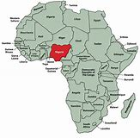
Geography
Located on the border of the Gulf of Guinea, between Benin and Cameroon
923,768.00 sq. miles
14th largest country in Africa
Natural resources include natural gas, petroleum, tin, iron, ore, coal, limestone, niobium, lead, zinc and arable land
Divided into 36 states and 1 territory

Slide 3
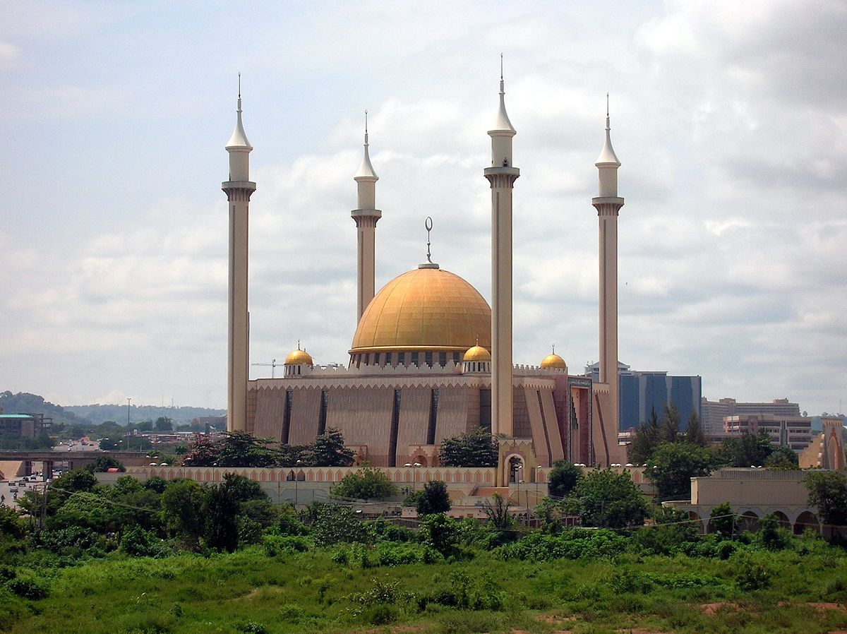
People and Society
203.5 million people
Population growth is 2.54%
Home to over 250 ethnic groups, including Hausa, Igbo, Yoruba and Fulani
Majority of the country is Muslim
English is the official language
50% of the population is located in urban areas
Literacy is 59.6%

Slide 4
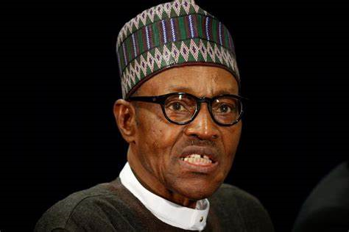
Government
Federal presidential republic
Leader is President Muhammadu Buhari, who serves as Head of Government, Commander in Chief, and Chief of State
Vice President is Oluyemi Osinbajo
Capital is Abuja
Bicameral National Assembly made up of a Senate and House of Representatives
Highest court of the judiciary branch is the Supreme Court
Legal system is a mixture of English Common Law, Islamic Law(in the northern states), and traditional law

Slide 5
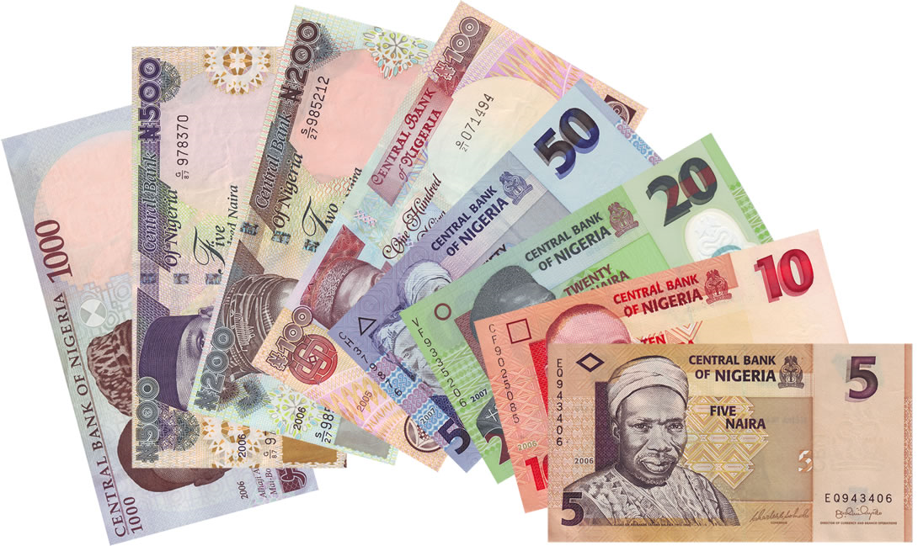
Economy
Largest economy of sub-Saharan Africa
Mainly relies on oil as its source of government revenue
70% of the population is below the poverty line
Agricultural products include cocoa, peanuts, cotton, palm oil, and corn
Industries include crude oil, coal, tin, rubber products, wood, and textiles

Slide 6
Other Facts
Colony of Great Britain until they gained independence on October 1st, 1960
Until 1999, it was ruled by military dictatorships, when they implemented a new constitution and a civilian government was formed
7 Major political parties, however the People’s Democratic Party governed from 1999 to 2015 when it was defeated by All Progressives
Major ethnic and religious tensions have caused violence
Boko Haram and Isis are very prevalent terrorist groups
77 million people are without electricity

